Slide 1
Creating More Golden Results in Chinese Golden Decade
( Re: Agricultural Economy )
Mr. Kaven XIE (Chairman)
延迟符

Slide 2
1
Chinese Agriculture in Golden Times
2
Funding Support Led by Chinese Government
CONTENTS
3
Trillion Capital Leveraged by Hundred Billion PPP
4
Service of Chinagoub Intellectual
Finance Group
1

Slide 3
1
Chinese Agriculture in Golden Times
2

Slide 4
Chinese Agricultural Situation & Technical Requirements
1. Current Situation of Agriculture: China is a huge agricultural country, and the technology is relatively backward; Due to China’s large population, China’s demand for supply of agricultural products stands the first in the world. The first, the second and the third industry have multidimensional and three-dimensional demand for agriculture;
2. Technical Requirements : The great importance attached by Chinese government to agricultural technology brings the agricultural development opportunities, and the government-guided technology fund set up by government reaches 1.2 trillion yuan; Low levels of agricultural technology brings the urgent demands for cooperation in many fields, including the demand of the first industry for science and technology, such as increase of production and modernized planting, and then the demand of the secondary industry and tertiary industry, especially the impending development demand of agricultural technology enterprises with technological content, and high and new technology enterprises involved in agriculture; At present stage, precision agriculture technology and equipment, food security problem and sustainable agriculture are much valued. At the same time, agricultural big data and the Internet of things technology, intelligent equipment and robot technology are blank to be filled;
3

Slide 5
Huge Consumption Market of Chinese Agriculture
3. Huge Market: China's huge market potential, updated consumption level, and the weakened quality competitiveness of China's domestic products due to a variety of problems have great demand for introduction of advanced technology, for example, due to China's food safety problems (milk powder, etc.), now many domestic people purchase foreign products by overseas online shopping, and if we introduce foreign production testing technology directly to the Chinese market, the demand must be huge. The further processing of agricultural products is also urgently needed in the Chinese market. Here we can introduce the situation of customers of our company, demands put forward, as well as the technical demands under planning.
4. E-Commerce Development: At present, the cost to establish trade channels in China is quite low because the E-Commerce and logistics industry are well developed. We can take the data of Taobao as an example (On November 11, 2016, the sales volume of one platform of Tmall is 120.7 billion). The companies don’t need to establish sales network in a large area of the land and have already good sales channels.
4

Slide 6
New Generation Innovation of Golden Decade
5. New Generation Innovation: The young people of new generation in China are willing to accept new things, the domestic situation for innovation and business start-up is good, and there are broad technical demands; Since the “Shuangchuang” was put forward, the number of new users of market main body has increased by 14.798 million, with the registered capital of 30.6 trillion, of which more than 99% are the small micro enterprise; The number of space for entrepreneurship and innovation across the country is 15000, of which 1337 are at the national level. The majority of these small and micro-sized enterprises are willing to invest in the technical field and the space for collaboration is very large.
6. Golden Time: The Chinese and Belgian government attach great importance to the collaboration between China and Belgium at present, and they are pushing forward the process, which is proved by the visit to the Belgium. At this stage, it is the best time for China and Belgium to develop collaboration of agricultural technology with the support of the government, for example, China Rural Technology Development Center of MoST. We hope to carry out the work with the help of the favorable conditions. Ultimately achieve " Creating More Golden Results in the Golden Decade”.
5

Slide 7
2
Funding Support Led by Chinese Government
6

Slide 8
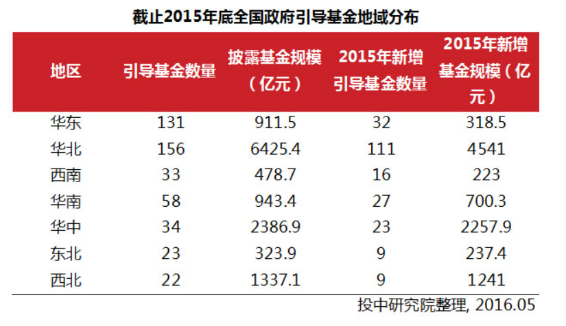
Geographical Distribution of Government-guided Capital in the end of 2015 in China
7

Slide 9
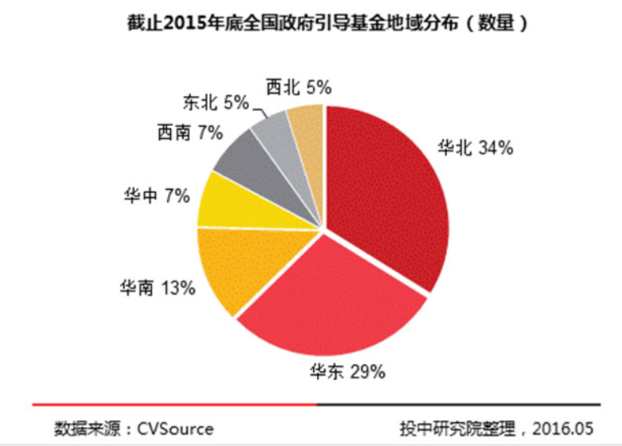
Geographical Distribution of Government-guided Capital in the end of 2015 in China
8

Slide 10
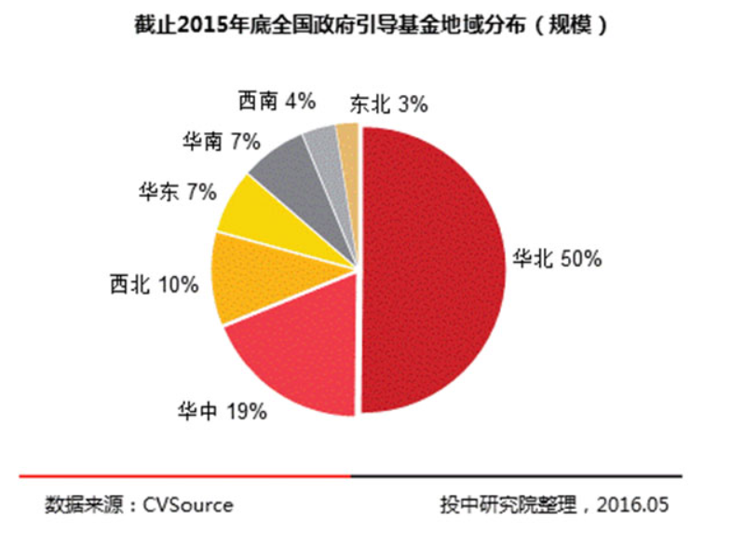
Geographical Distribution of Government-guided Capital in the end of 2015 in China
9

Slide 11
Geographical Distribution of Government-guided Capital in the end of 2015 in China
Among all guiding fund established in 2015, the scope of Hubei Yangtze River Economic Belt industry fund is the largest.
The 200 billion Yangtze River Economic Belt industry fund is set by the government guiding fund of RMB 40 billion Yuan contributed by Hubei finance department and 160 billion Yuan raised from financial institutions, enterprises and social capitals, which will promote the capital lever rate of 4 times.
This guiding fund will focus on the rapid development of seven emerging industries, including new generation of information technology industry, high-end equipment manufacturing, biological medicine, energy saving and environment protection, new energy and new energy auto, transfer and updating of traditional pillar industry, breaking development of modern service industry, green, technical and ecological agriculture and industrialized development. The establishment of sub-funds are multilevel and diverse, including merge, combination of stock and debt, NEW OTCBB, new forth board, Pre-IPO, PE, VC, angle and other different stages and types.
10

Slide 12
3
Trillion Capital Leveraged by Hundred Billion PPP
11
延迟符

Slide 13
Central and local governments set up hundred billion PPP guiding fund in 2016 which will promote trillion capital
Policy Guidance：
Since the core concept of “social capital is allowed to participate into the urban infrastructure investment and operation through franchise” put forward in the Third Plenary Session of the 18th CPC Central Committee, China broadens the investment channel of private capital and gives the right of franchise for private capital.
The development of PPP pattern is favorable for the public to enjoy excellent and highly effective public service, cultivating new energy for the economic growth as well as promoting the “double engine” of creating public entrepreneurship and mass innovation, increasing public products and services.
On May 19, 2015, the General Office of the State Council transmitted the notice of Directive Opinion on Promoting the PPP Pattern in Public Service Area issued by the Ministry of Finance, Development and Reform Commission and People's Bank of China (hereinafter referred to as “No.42 Document”). The release of No.42 Document makes clear the compliance and legality that social capital participates into public service sector projects and gains the right of franchise, which activates the mutual benefit and win-win pattern between private capital and governments at various levels.
12

Slide 14
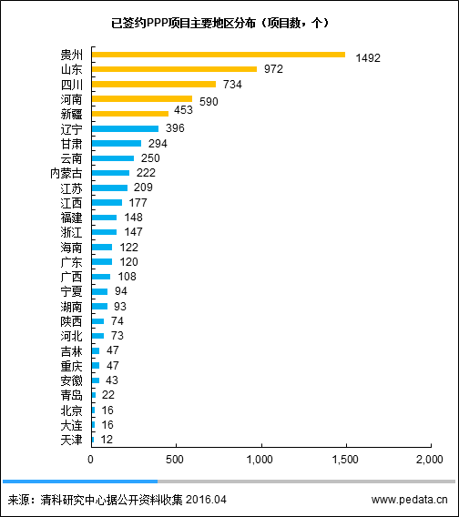
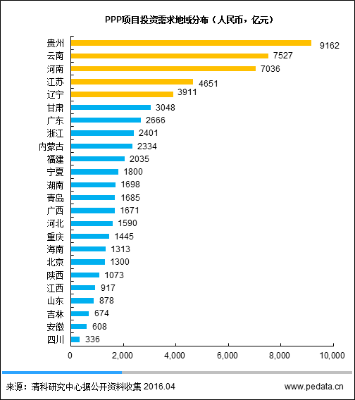
Central and local governments set up hundred billion PPP guiding fund in 2016 which will promote trillion capital
Hundred billions PPP of guidance funds set by the central government and regions in 2016 shall prize trillions of capitals.
13

Slide 15
4
Service of Chinagoub Intellectual
Finance Group
14
延迟符

Slide 16
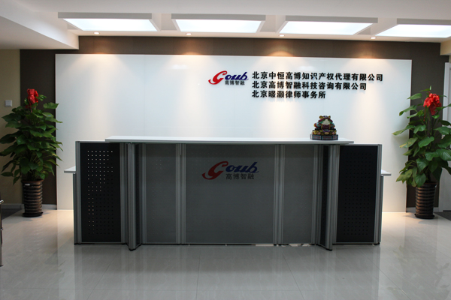
Briefing
Chinagoub is not only a leading consulting service vendor in the technology, financing and international technology transfer industries,etc, but also a prospective commercial enterprise built to meet the various needs produced in the knowledge-oriented economy. Chinagoub has initiatively advocated and promoted the idea of One-stop Service combining Intellectual Property, Finance and International Technology Transfer.
优秀员工25%
创始人
25%
Branches
Employees
Achievements
21 subsidiaries
Branches and Liaison offices located in 8 countries (or regions)
200 staff
40% of them with
master degree,
About 50 people with national approval certificates
Conduct more than 100,000 pieces of cases and serve for about 10,000 enterprises and individuals
15

Slide 17
Technology Financing Business
IP Basic Business
Advice and Support for Technological Innovation
Incubators, Accelerators and Other Supporting Services
International Technology Transfer
Legal Affairs
Business Scope
16

Slide 18
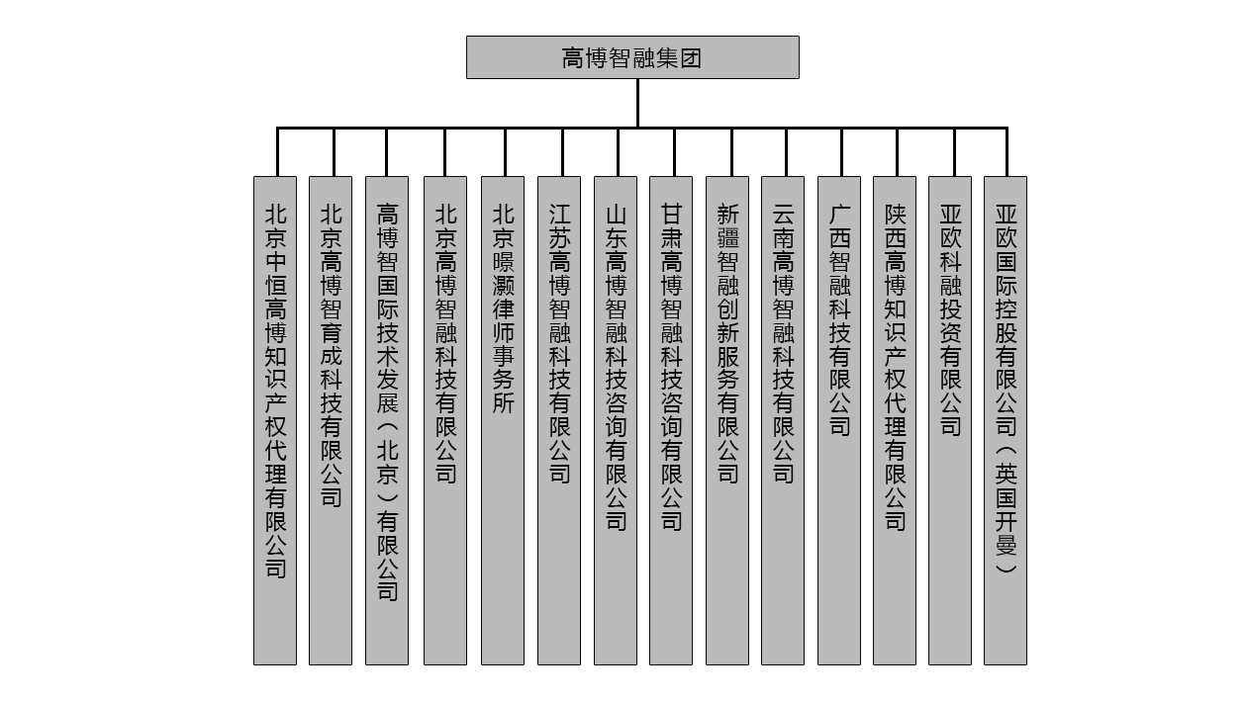
Frameworks of Chinagoub & Subsidiaries
17

Slide 19
Overseas Business Units of Chinagoub Group
Recent three years, Goub Group have established cooperation relations with the European Union Innovation Center in China,
famous technology transfer organizations in the United States, UK, Germany, Italy, Arab States, Japan, Korea, Taiwan, Hong Kong and other countries and regions.
18

Slide 20
Chinagoub
Asia-Europe Technology Financing Investment Co., Ltd.
Focusing on international technology transfer, international enterprise management consulting, holding international conferences &exhibitions etc.
Beijing Goub Cultivation Technology
Co., Ltd.
A fund management company built by Peking Univesity Yanyuan Group, AITIA and Chinagoub
With rich experience in innovation operation and management. Combining domestic government resources, it offers the cultivation services for international technology transfer institutions and investment institutions, and build the first capital incubation platform in China
2
1
3
Create the international technology transfer ecosystem
19

Slide 21
Contact Us
Address: Room A, 23rd Floor, A Building of Linda Plaza, 8# Dongtucheng Rd, Chaoyang District, Beijing China
Post Code: 100013
TEL: +86 10 64462392
Mobile: +86 15313690632
Email: kavenxie@chinagoub.com
Web: www.goubgroup.com
20
延迟符

